Slide 1
Anti-Corruption Reforms and Shareholder Valuations: Event Study Evidence from China
Authors: Chen Lin, Randall Morck, Bernard Yeung, Xiaofeng Zhao
Presenter: Yuying(Cynthia) Wang
9/19/2017 in St. Louis

Slide 2
Content
Background introduction
Event description
Methodology and data
Empirical findings
Conclusion

Slide 3
Notes:
CORRUPTION PERCEPTIONS INDEX 2012
US ranks 19 with a score of 73
China ranks 80 with a score of 39

Slide 4
Background introduction
What causes corruption?
Personal – greed; less ethical sensitivity; lack of courage
Cultural – everyone does it;
Institutional – inefficient control; lack of penalization
The condition described in the paper
An investment in official “connections” to “grease the gears” of the bureaucracy and “get things done”
Corporate insiders hone skills for building connections, not for managing firms
Political rent-seeking – negative externalities

Slide 5
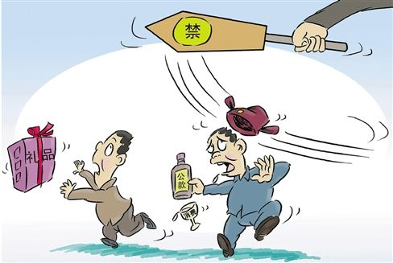
Background introduction
Connections, or guanxi （关系）, is a historically and culturally deep-rooted part of business of China
Developing connections is a normal and respectable part of doing business
Then there is a stable suboptimal political-economy equilibrium
To destabilize this equilibrium, a political shock becomes a necessary precursor.
Notes:
i.e. providing a government official with extravagantly expensive wining and dining, entertainment, travel, gifts or other de facto bribes

Slide 6
Notes:
Everyone know the corruption problem, but it is difficult to change it without government policy

Slide 7
Event Description
Political event:
Hu Jintao – Wen Jiabao administration’s predetermined term ended in 2012
Xi Jinping administration assumed office amid an ongoing struggle between multiple Party factions for political power and economic gain
The Party’s 18th National Congress, on Nov. 8th to 14th 2012
Marked the official transfer of power
Not a smooth transfer
Xinhua News on Nov. 20th 2012
A report arguing the Party must fight corruption and treat this as a major political task
Attacks on corruption after an important transition are often mere rhetoric, or even smokescreens for purging political opponents
Notes:
i.e. Bo Xilai was dismissed as Chongqing’s Party Secretary on March 15th and expelled from the Party on Sept 28th
i.e. formal president Jiang Zemin and other party veterans returned to center stage; the departing President Hu Jitao unexpectedly relinquished all his titles and positions

Slide 8
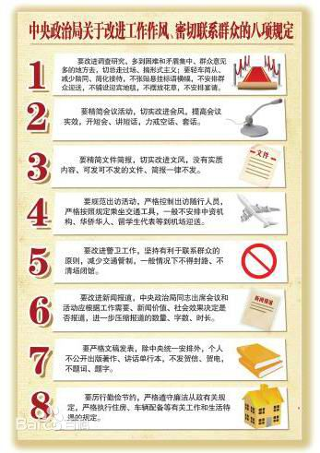
Event Description
This was a policy document by the Politburo of the Central Committee of the CPC
The Eight-point Policy（八项规定）, Dec. 4th 2012:
Leaders must keep in close contact with the grassroots, but without inspection tours or formality.
Meetings and major events are to be strictly regulated and efficiently arranged; empty grand gestures are to be avoided.
The issuance of official documents must be reduced
Overseas official visits and related formalities are to be restricted
Leaders traveling by car must avoid disrupting traffic
Media stories about official events are to be limited to events with real news value.
Government leaders should not publish self-authored works or congratulatory letters.
Leaders must practice thrift and strictly obey regulations regarding accommodation and cars.
Notes:
A surprising event: 1. unusual time; 2. unusually concretely detailed and free of slogans; 3. came amid official warnings of unusual clarity
And this was the only major news on that day(WIND, CSRC, People’s Bank of China, Ministry of Finance, etc.)

Slide 9
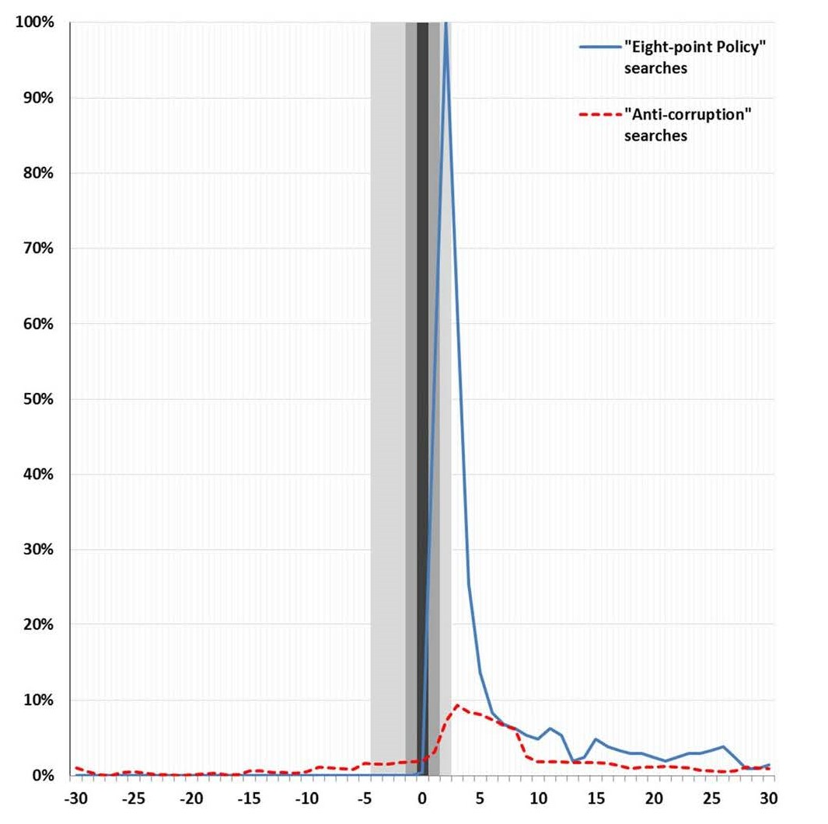
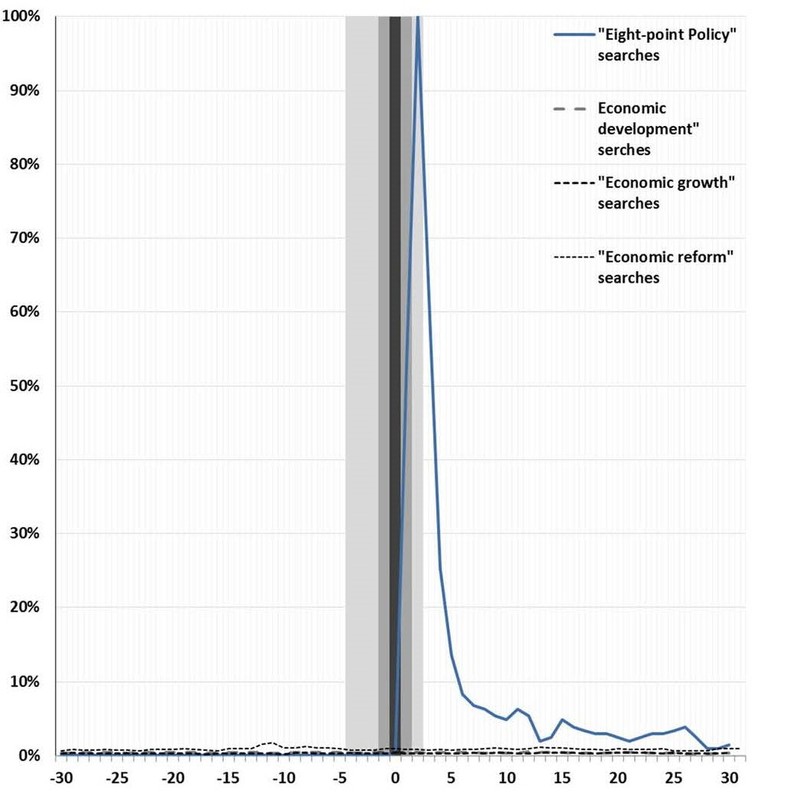
Search Engine Data
Notes:
See how popular this policy was

Slide 10
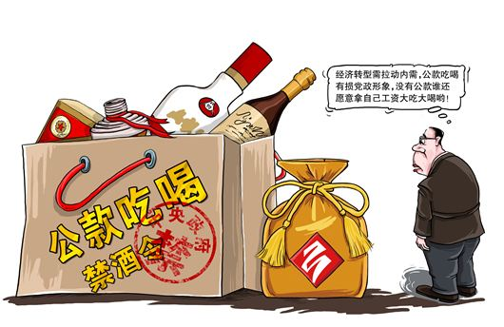
Methodology
The market portfolio’s raw return on and around the event date
Different sorts of firms
Provinces
Characteristics
Explore heterogeneity of different sorts of firms
Running regression explaining either firm-level cumulative raw returns or abnormal returns
Notes:
The Eight-point Policy was designed to affect the entire economy, not specific firms, and to affect all firms at once.
This motivates our first examining the market portfolio’s raw return on and around the event date, instead of subtracting it to form abnormal returns.

Slide 11
Data
Sample:
All firms listed on China’s two stock exchanges
The Shanghai Stock Exchange and the Shenzhen Stock Exchange
Dropping all firms with material corporate events in the five-day event window surrounding the Dec. 4th event date
Firm Type: SOEs and nonSOEs
Investment in Connection
Entertainment & travel cost(ETC)
Development of market institutions
Province-level marketization index produced by National Economic Research Institute
Notes:
Such as stock or cash dividends, stock splits or reverse-split, new share issuances or M&A announcement

Slide 12
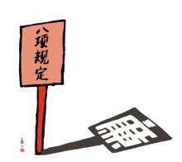
Data – Marketization Index
Notes:
The marketization index, ranges from 0 to 10 in the base year 2001
It can exceed ten or fall below zero in subsequent years to reflect a province’s progress or retrogression over time
Hainan Province as a benchmark
Also use NERI sub indexes as proxies, includes:

Slide 13
Empirical findings – raw returns
Notes:
All numbers are in percentage.
The movement in the market in two windows: 3-day and 5-day
2.6% and 3.3% = 600 and 760 billion RMB increases
Only 25.9% and 23.9% company value dropped

Slide 14
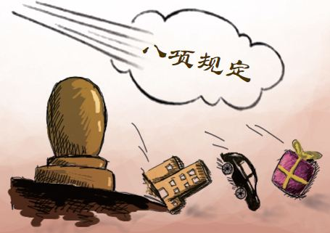
Province level
Notes:
Horizontal line: cumulative returns, weighted average by firm value

Slide 15
Empirical findings – regression on raw return
Notes:
Dependent variable: raw returns, weighted sum on market value of each firm whose headquarter locates in this province
Independent variables: listed in first column
There are two regression models, using different proxies for the marketization level
All of them, except the log of GDP per capita, are significant on no matter 10% 5% or 1% significant value
First two columns: 3-day window

Slide 16
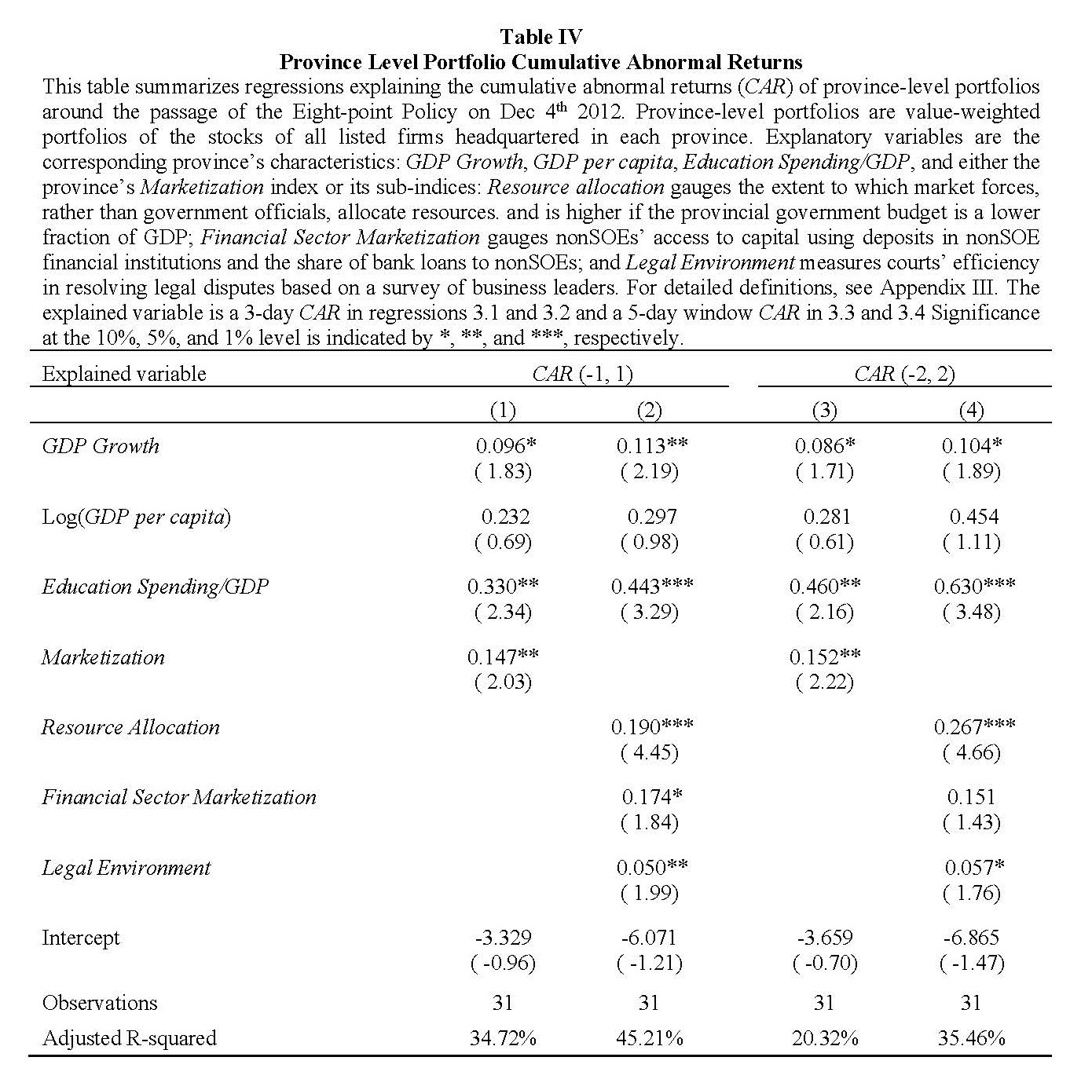
Empirical findings – regression on abnormal return
Notes:
Dependent variable: abnormal returns
Gained by estimated over the period from day -210 to -11 → a normal return over 200 day period
The results are consistent from previous regression model

Slide 17
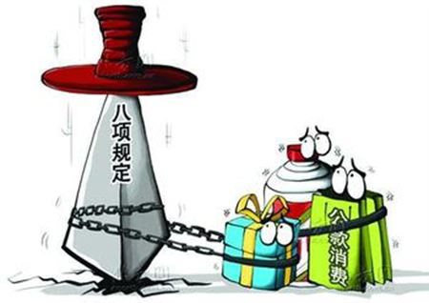
Empirical Finding
Reductions in corruption being more advantageous to firms in provinces with faster GDP growth, larger stocks of human capital, and more developed market institutions.

Slide 18
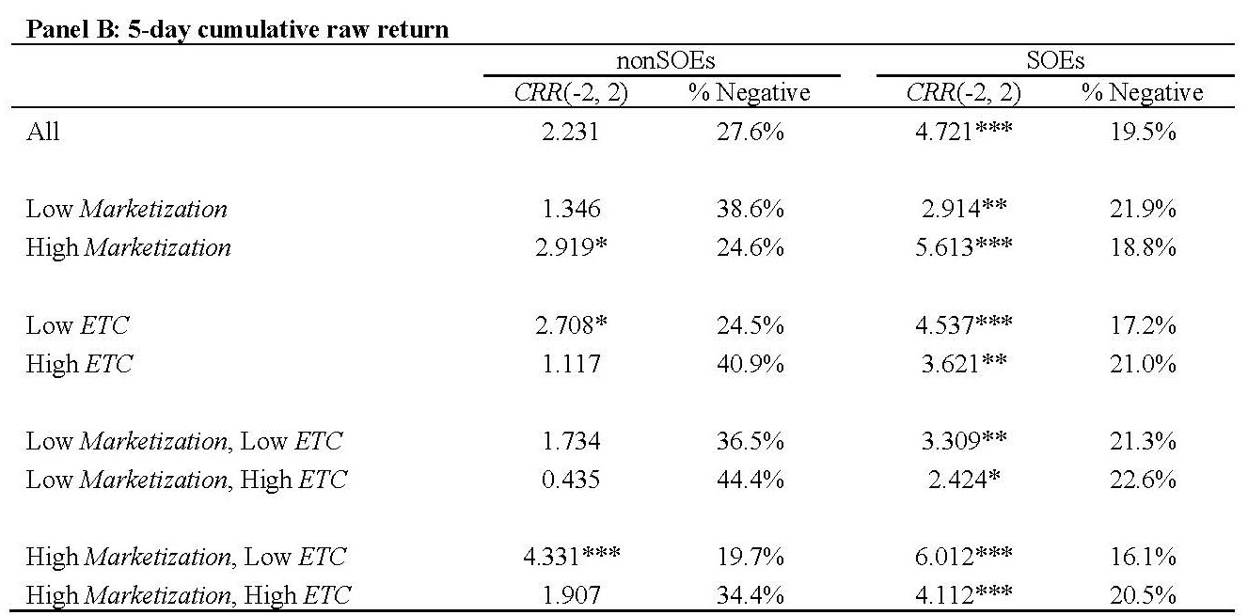
Empirical findings – raw return and more
Notes:
3-dimensions results; whether a SOE, whether locates in a high marketization province, whether having high Entertainment and travel cost
All nonSOE gaining insignificantly(+1.14%), but those in high marketization provinces gain significantly(+1.83%); also true to High Mkt and Low ETC
All SOEs gaining significantly; the rankings of the returns echo those of the analogous nonSOEs subportfolios

Slide 19
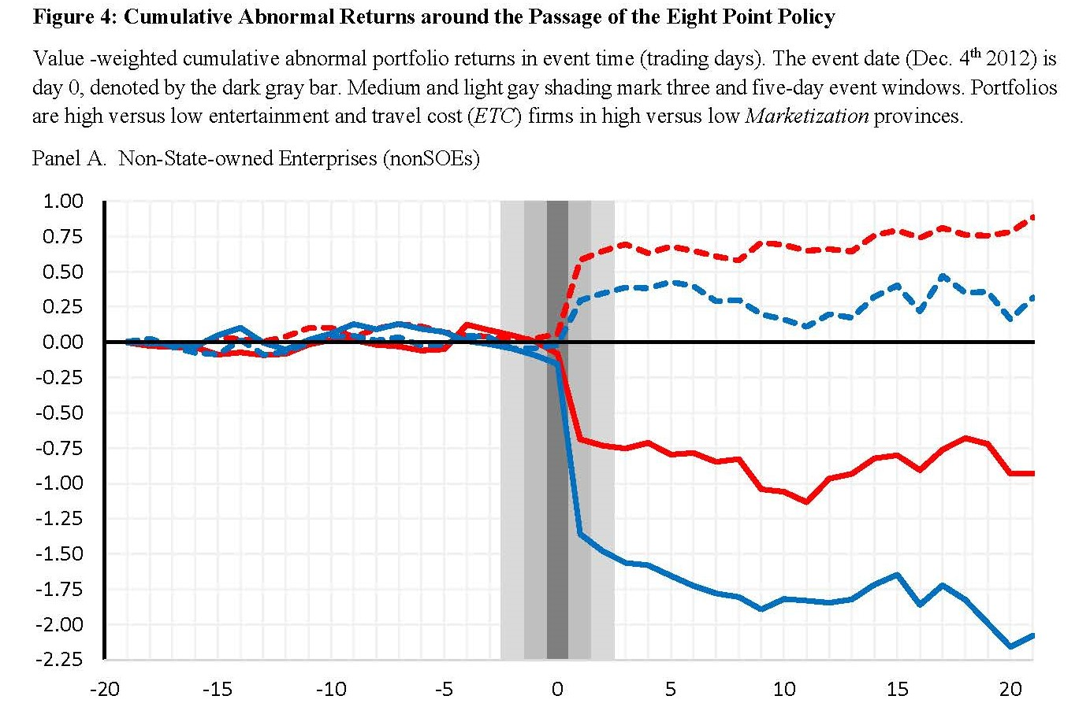
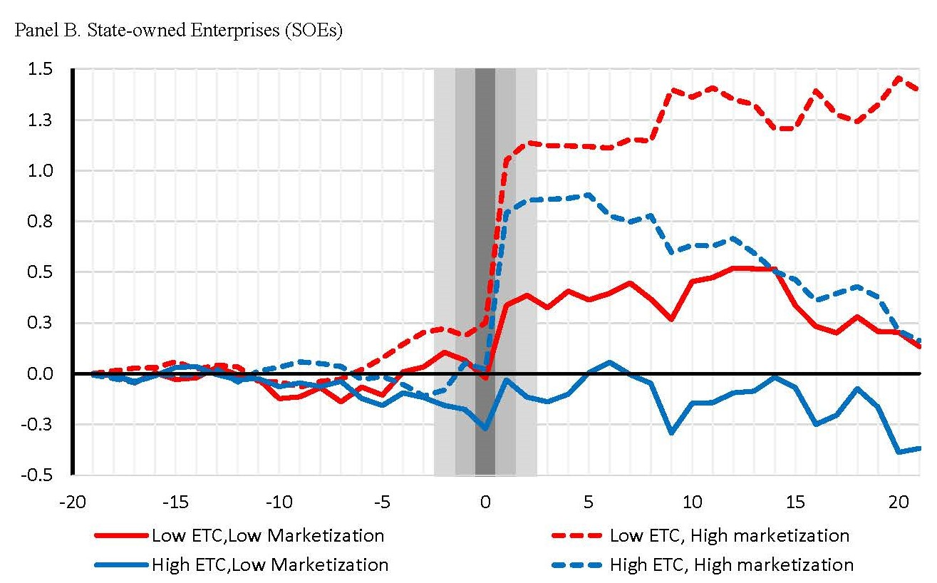
Empirical findings – raw return and more
Notes:
In short, a firm, being a SOE, previously having low ETC, locating in a high Mkt province, will have very positive response in mkt value

Slide 20
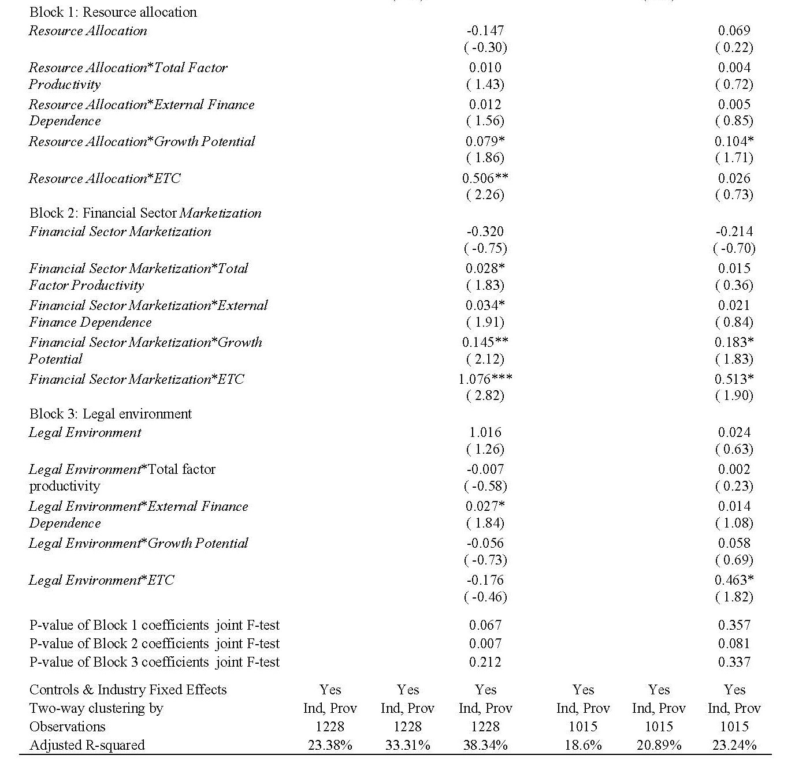
Firm-level Regressions
Notes:
What different from previous regression: a firm-level, dividing the firms into nonSOE or SOE catagories
I don’t want to go through all the details. But the key things here is: significant coefficients are different for the two groups.

Slide 21
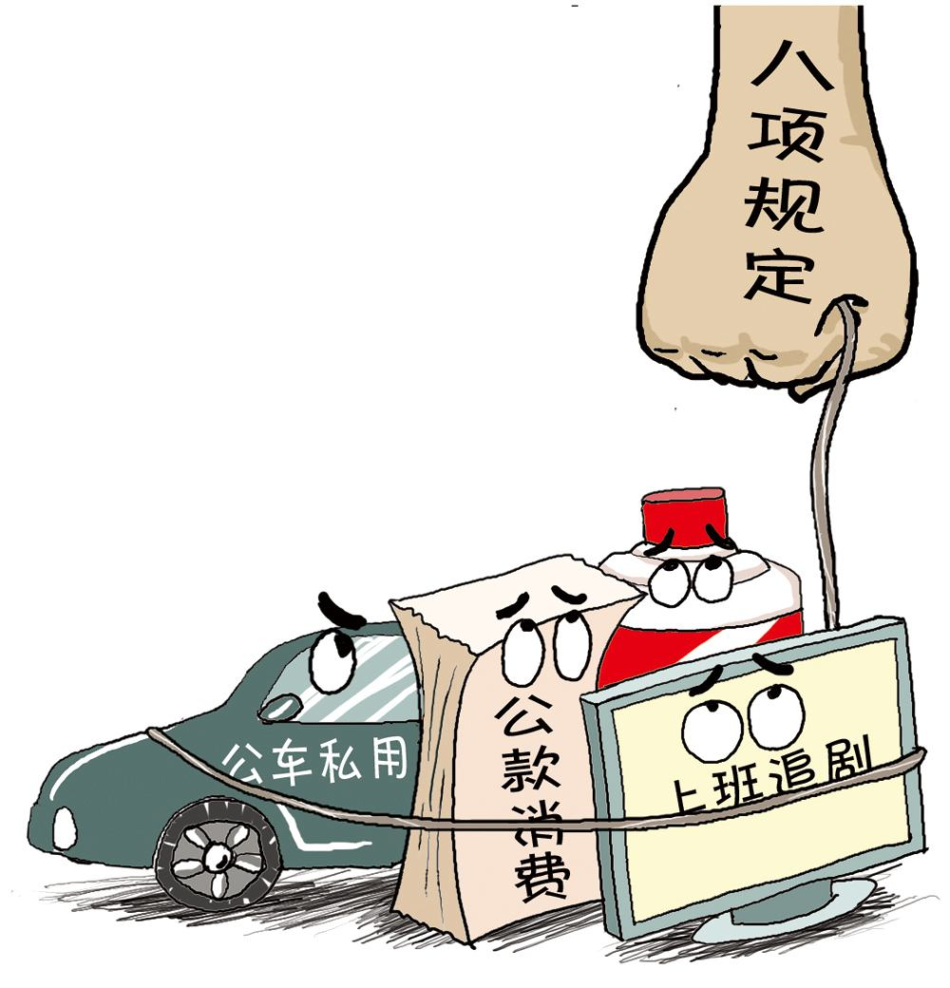
Firm-level Regressions - findings
Investors expected reduced corruption to better help more productive nonSOEs that have more growth potential and need external finance if they are located in provinces with more developed market institutions.
Likewise, investors expect curtailing corruption to better help SOEs with more growth potential if they are located in provinces with stronger market institutions.
SOEs having ready access to financing without having to invest ETC to build connections.

Slide 22
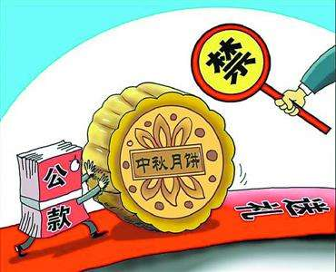
Firm-level Regressions – change to Firm Performance
Shareholders’ expectations → firm-performance in next year
Changes in daily market-to-book ratio
Changes in firm’s return on assets
Changes in sales growth
The regressions echo those before
Notes:
I did not put the tables here, too much number and variables, check the paper if you are interested

Slide 23
Robustness
Not driven by usual provinces
Exclude Tibet, Beijing, Shanghai
Not driven by differently regulated industries
Exclude financial and real estate firms
Rerun using total assets to scale R&D and ETC rather than total sales
Re-estimate Chinese mainland firms listed in HK
Examine the stock returns around Nov. 20th 2012 - insignificant
Notes:
Tibet: cultural, social, political, and economic characteristics differ substantially from others
BJSH: have most developed province-level jurisdiction and firms with nationwide operations tend to be headquartered in them.
HK: most of these shares are not cross-listed on mainland exchanges, and Hong Kong accounting rules do not mandate the disclosure of entertainment and travel costs. Not a meaningful comparison.
Nov. 20th: Information leakage is a potential concern in event studies. INSIGNIFICANT

Slide 24
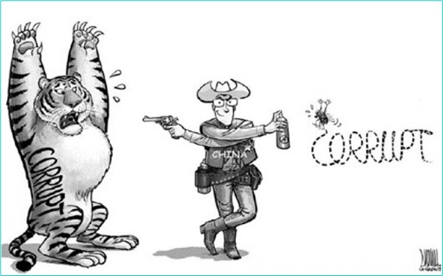
Discussion
The Eight Point Policy was just the beginning of anti-corruption in China. It’s worthy to figure out the market performance for succeeding events.
http://fanfu.people.com.cn/GB/64374/index.html
Zhou Yongkang, July 29th, 2014
Ling Jihua, Dec. 22nd, 2014
Anti-Four winds（反四风）, Jun 18th, 2013
The effectiveness of anti-corruption
The cutting of ETC is a by-product of political struggle

Slide 25
Conclusion & Take-aways
Listed SOEs’ shares gained more than nonSOEs’ shares.
Firms located in provinces whose market reforms were more advanced gained more.
More competitive firms, more external finance-dependent firms, and less connected firms all gain more if the firms are located in provinces with more advanced market reforms. These differences are also more pronounced for nonSOEs than for SOEs.
The stocks of nonSOEs in less reformed provinces gain less if they had reported higher entertainment and travel costs (ETC).

Slide 26
Reference
https://www.transparency.org/cpi2012/results#myAnchor2
http://fanfu.people.com.cn/
https://zh.wikipedia.org/wiki/%E4%B8%AD%E5%85%B1%E5%8D%81%E5%85%AB%E5%A4%A7%E4%BB%A5%E6%9D%A5%E7%9A%84%E5%8F%8D%E8%85%90%E8%B4%A5%E5%B7%A5%E4%BD%9C

